Slide 1
The Net who Cried Hyrax
Real Time Rock Hyrax detection and classification
Using Keras and TensorFlow
Oded Kalev, Noa Simon, Noa Rahamim

Slide 2
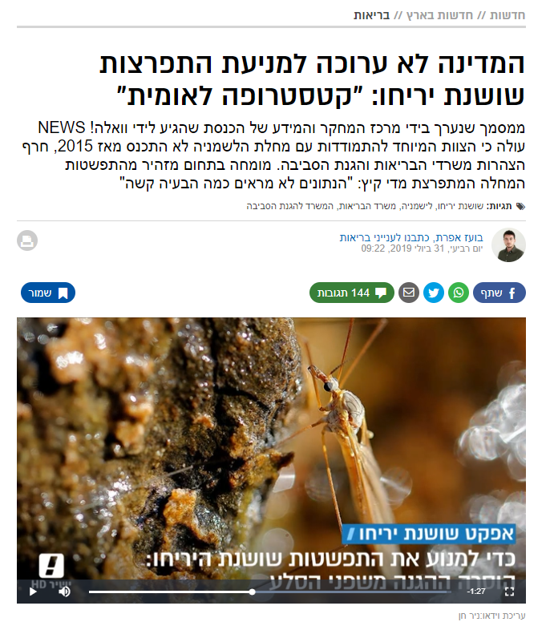
אודותינו
Rock Hyrax are main carriers of Leishmania
Phlebotomus pass this disease to humans
Efforts are made in order to prevent sprading of the disease by distancing of the Phlebotomus and the Rock Hyrax from human living areas

Slide 3

Data acquisition
Building a data set turned out to be non-trivial task
Google Images
YouTube Videos
Videos We Filmed
Filtering
Break to frames,
Tag
Film,
Break to frames,
Tag
Labels for classification and detection

Slide 4
detection
Detection
TensorFlow ObjectDetectionAPI
Using SSD mobileNetV1 pre trained on COCO dataset
It was more than what we needed…

Slide 5
classification
Keras implementation of InceptionV3
Pre trained on ImageNet
Balanced data, between and within labels
More thing that we will do

Slide 6
Questions?
Oded Kalev, Noa Simon, Noa Rahamim

